Slide 1

Research Progress Record
Enmao Diao
June 03 2021

Slide 2
Overview
Gradient Assisted Learning
Semi-Supervised Federated Learning
Multimodal Controller for Continual Generative Models
Compressing Turbulence
Assisted Recommendation System
Federated Distillation
Gradient Decentralized Neural Network
Finite Neural Networks
Others

Slide 3
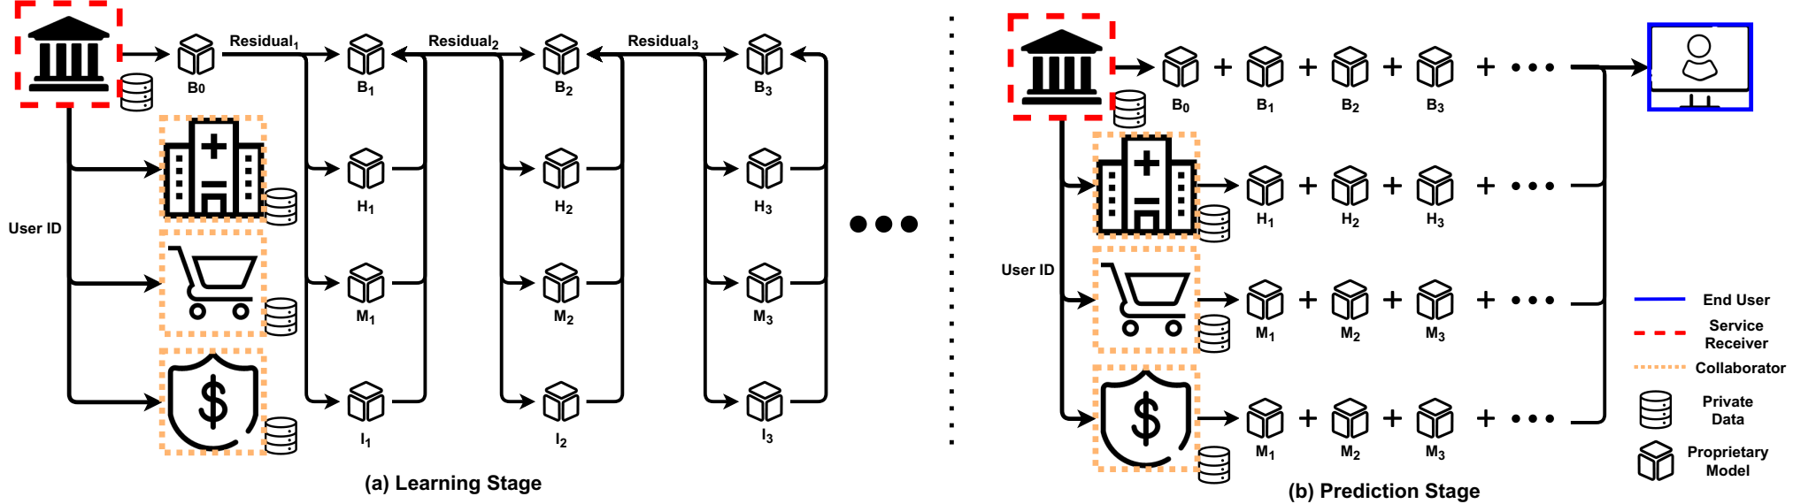
Gradient Assisted Learning
Rejected by ICML 2021
Resubmitted to NeurIPS 2021
We propose Gradient Assisted Learning (GAL), a new method for various entities to assist each other in supervised learning tasks without sharing data, models, and objective functions.

Slide 4
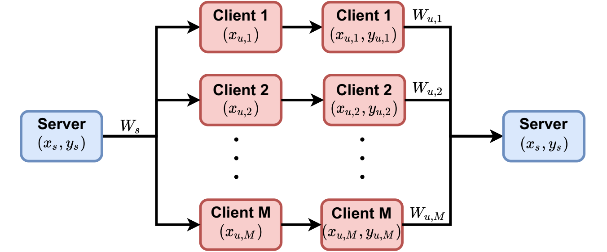
Semi-Supervised Federated Learning
Submitted to NeurIPS 2021
We propose a new Federated Learning framework referred to as SemiFL in order to address the problem of Semi-Supervised Federated Learning (SSFL).

Slide 5
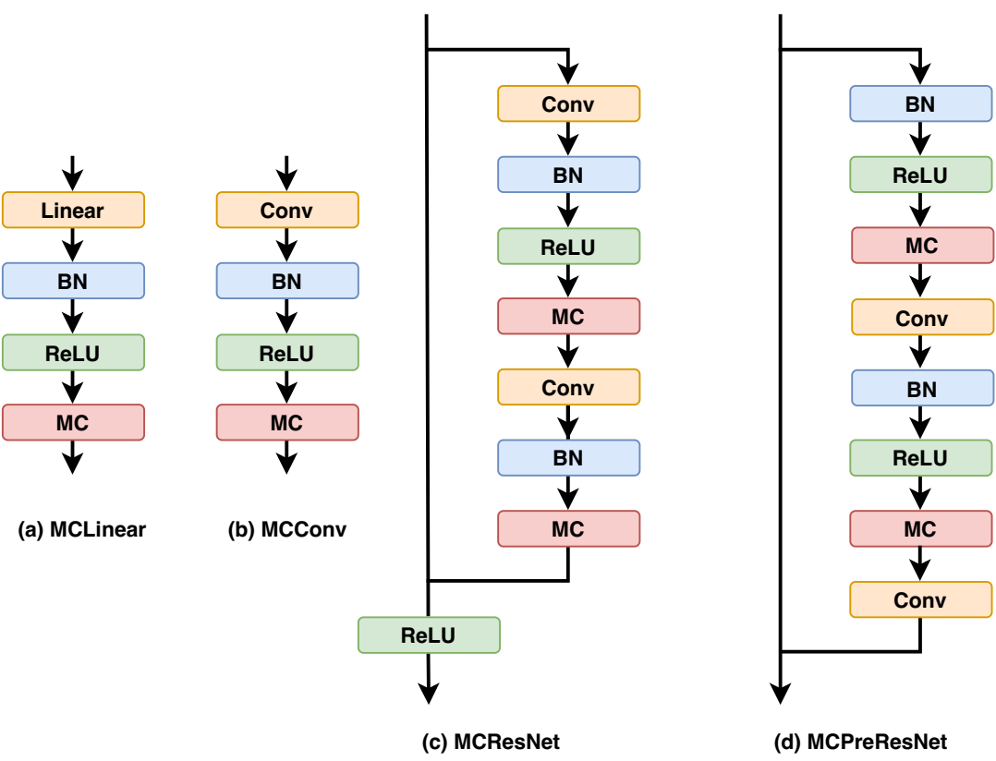
Multimodal Controller for Continual Generative Models
Submitted to ICCV 2021
Other options: BMVC 2021, ACCV 2021

Slide 6
Compressing Turbulence
Compression journal submitted to Physics Review Fluid
Prepare sequential learning for journal
Prepare compression for a conference or workshop paper
DCC 2022
AAAI-MLPS2 2022

Slide 7
Assisted recommendation system
Use gradient assisted learning to train vertical-split recommendation data
Noisy alignment
Retrain models along boosting path
Multiple organization (companies) collaboratively learn a recommendation system
Prepare for AAAI 2021

Slide 8
Federated Distillation
Federated Distillation with random noise input data
Use static BatchNorm to avoid label statistics shift
Attempt Vertical, Horizontal (IID,Non-IID)
Prepare for ICLR 2022

Slide 9
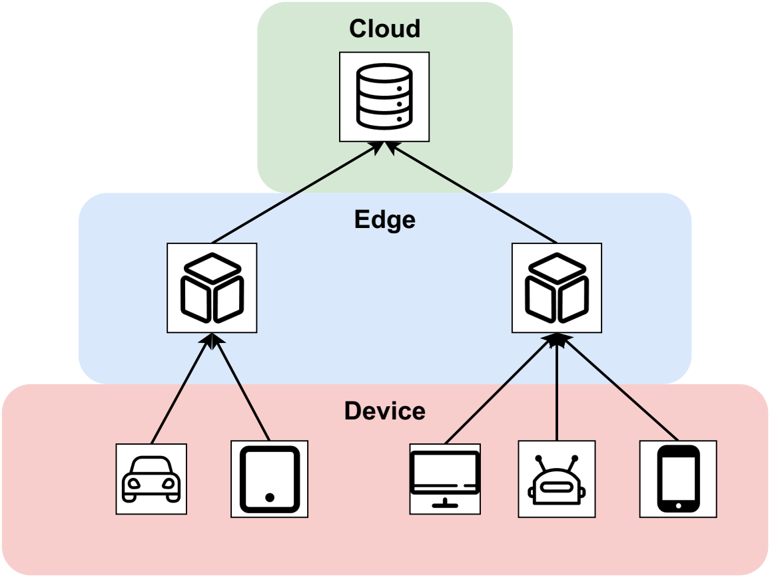
Gradient Decentralized Neural Network
Boosting on Edge
End, Edge, Cloud each hosts a model to train the residual passing from lower level. End device is the lowest and has all the data. The features and residuals are transmitted to next level
Multiple iteration of boosting may also work
Prepare for ICLR2022

Slide 10
Finite Neural Networks
Input, weights and output are all on finite field
I find formal derivatives can be defined for finite field with product rule of calculus
In mathematics, the formal derivative is an operation on elements of a polynomial ring or a ring of formal power series that mimics the form of the derivative from calculus.
https://en.wikipedia.org/wiki/Formal_derivative
For example d(X^5)/dx = 5X^4 which means summation of X^4 5 times. d(f(X)/5)/dx = 1/5 d(f(X))/dx in finite field means find a value that when add 5 times equal d(f(X))/dx.
I think it is feasible to implement Finite Neural Networks with these definition.

Slide 11
Others
SINGAN
GAN with siren networks
Use hypernetwork to generate weights of GAN
not working for now
WNet
Use Wavelet to replace Fourier Transform in FNet
For time series prediction, classification problem
AETA earthquake competition
Computer Audio processing

Slide 12
Others
Deep Channel Coding
Frequency domain or wavelet-based channel coding with Fourier operator
Defend adversarial attacks from intermediate layers
Hypothesis: Even though we only change very little to the input image and easily attack trained neural network. Intermediate layer features should have a very different distribution from the trained dataset. The change of result cannot happen within one layer. It is the deep nature makes classifier fragile
Design a simple Defensive BatchNorm to check statistics

Slide 13
Others
Neural Wavelet Transform
Train the kernel inside wavelet to replace convolution layer to reduce computation and kernel size
Possible extend to other integral transform
Apply for compression and classification
Predictive gradient descent, meta-learning
Forget about learning rate. Theoretically there always exists a best gradient step at each iteration. We use learning history as our training data and predict the best gradient step. Deep Learning for optimization.

